Slide 1

AARP Housing Advocacy
NJAAW 2026 Age Friendly Summit
September 16, 2026
Samar Jha
Government Affairs Director
Livable Communities, Government Affairs, AARP

Slide 2
Factors Impacting Affordable Housing
There are several contributing factors impacting the lack of affordable housing, including:
Land use regulations (zoning) that limit the types of housing that can be built.
01
The amount of land zoned to allow rental housing, and housing at higher densities
02
Increases in construction and development costs
03
Lack of financing and capital available for homeowners and builders looking to invest in workforce,
affordable, and low-income housing
04
Lack of government funds earmarked for housing
05
The growth of institutional investment in housing (following recent foreclosures)
06
Allowing institutional investors to take over foreclosed property, (only to sell it for a higher price)
07
Transfer taxes, development impact fees, and other soft costs
08
Increasing property taxes
09
Urgent repair issues and home health hazards
10

Slide 3

Chicken Coop Story
AARP FOUNDER:
Chicken Coop Story:
Dr. Ethel Percy Andrus
Andrus founded a separate organization, the National Retired Teachers Association (NRTA) in 1947.
“I knocked on the sagging door of
the windowless shed and assured the answering voice that I had come to say ‘Howdy’ — one teacher to another — and I asked if I might
not come in.”
Subsequently, AARP was founded in 1958.
Notes:
SJ to present

Slide 4
What People 50+ Think About Where They Will Live
51%
75%
73%
44%
Believe they will move to allow them to age independently
Want to stay in
their homes
Stay in their communities
Expected to relocate, with housing costs being a primary motivator
Source: 2024 AARP Home and Community Preferences Survey: A National Survey of Adults Age 18+
Notes:
SJ to present

Slide 5
Lifecycle of Housing – Housing for All Ages
This illustration shows different living scenarios, or stages, for one family. Individuals may experience one or more of these scenarios in their lifetime. However, everyone—single-person households, families with kids, single parents, adults without kids, older adults, and grandparents caring for children—needs housing options that fit their needs as they age.
SCENARIOS WITHIN A FAMILY
Single, early-career working adult
Family with young children
Multi-generational family
Early
retirement
Older
adulthood
Housing priorities may include:
Well-connected location with
good access to public transit
and amenities
Lower-cost housing, such as a small home or shared home with
a private bedroom
Access to good schools and parks
Enough bedrooms for the family
Combination of private and shared multigenerational spaces
Universal design features
Options to downsize in community
Options for additional income
Accessible homes in their community
Proximity to family/adult children and community amenities
Age in place
Accessible homes in their community
Proximity to family, health care and support services, and public transit
Multifamily Housing (e.g, Apartment or Condominium)
Garden Style Apartments
Multigenerational Housing
Single Family with Accessory Dwelling a
Unit
(ADU)
Multifamily Housing (e.g Apartment or Condominium)
Multifamily Housing
(e.g Apartment or Condominium)
Multifamily Housing (e.g, Apartment or Condominium)
Triplex/
Fourplex
Accessory Dwelling Unit (ADU)
Single family
Townhomes
Duplex
Accessory Dwelling Unit (ADU)
Single family
Senior Housing
Single family
Source: Housing for All Ages: An Infographic

Slide 6
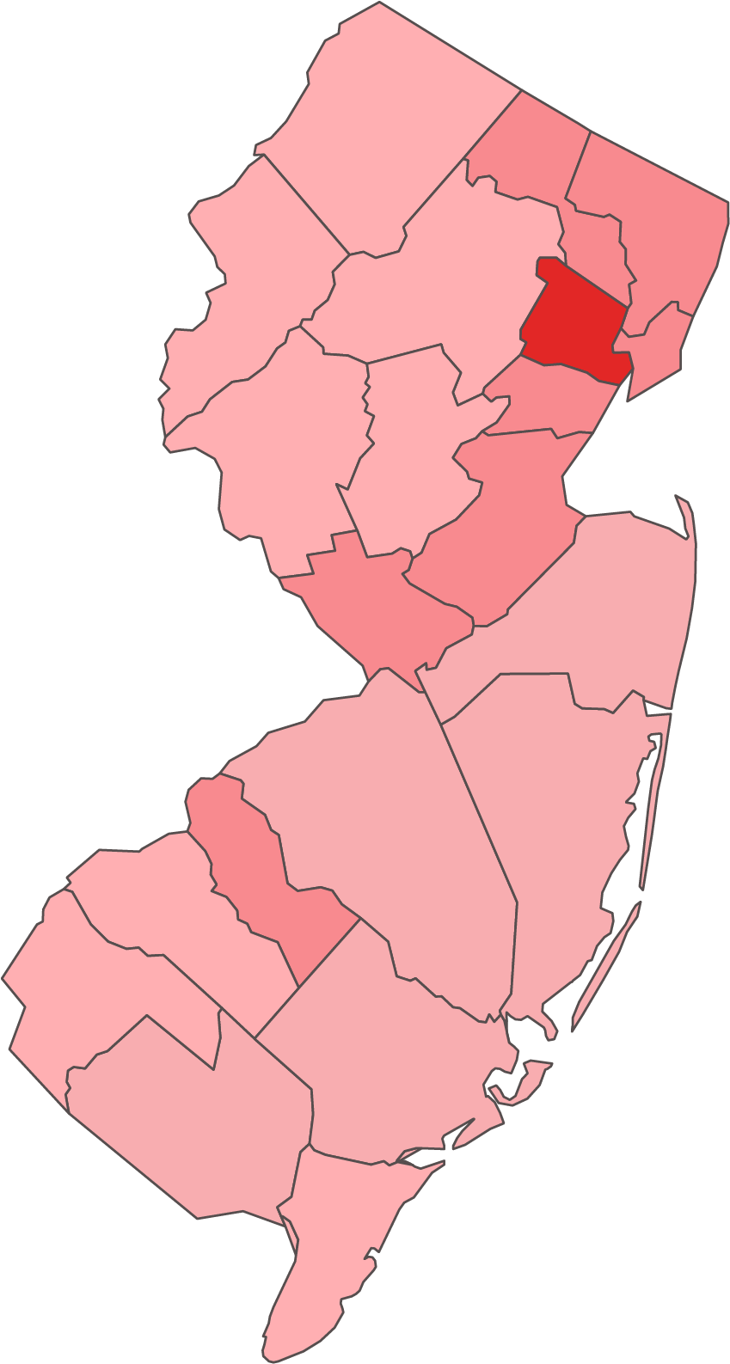
Expected No. of Evictions in 2026 – All ages
Essex County
Camden County
Hudson County
Union County
Middlesex County
Passaic County
Mercer County
Bergen County
Atlantic County
Burlington County
Monmoth County
Ocean County
Cumberland County
Gloucester County
Morris County
Somerset County
Salem County
Warren County
7,204
2,765
2,488
2,181
2,088
1,864
1,857
1,690
1,425
1,408
1,209
975
781
745
661
578
331
310
-0.2%
Compounded Annual Growth Rate
2026-2027
31,159
Source: Statista/AARP analysis of data available by United States Census Bureau (USCB)

Slide 7

Expected No. of Evictions in 2026 – 45+
Essex County
Camden County
Hudson County
Union County
Middlesex County
Mercer County
Bergen County
Passaic County
Atlantic County
Burlington County
Monmoth County
Ocean County
Cumberland County
Gloucester County
Morris County
Somerset County
Warren County
Salem County
3,444
1,359
1,121
1,063
1,021
908
892
892
764
735
667
609
398
366
364
308
182
179
-0.1%
Compounded Annual Growth Rate
2026-2027
15,649
Source: Statista/AARP analysis of data available by United States Census Bureau (USCB)

Slide 8
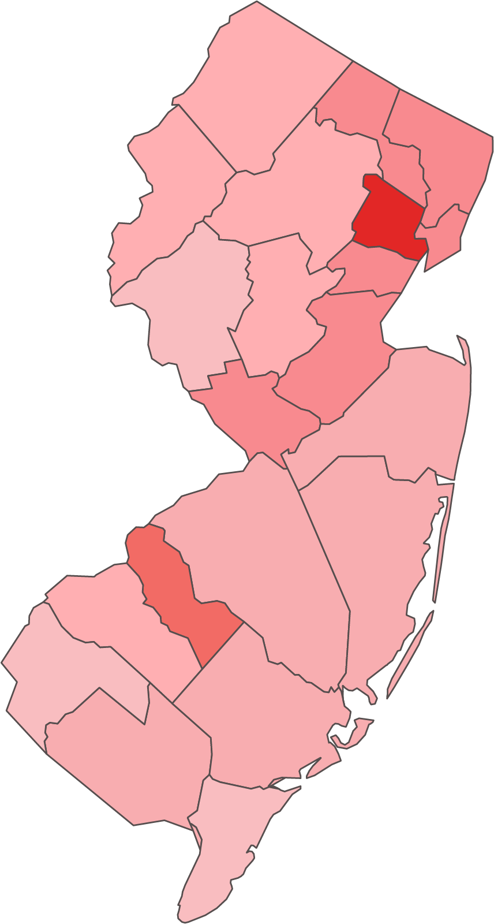
Expected No. of People Experiencing Homelessness in 2026 – All ages
Essex County
Camden County
Hudson County
Union County
Middlesex County
Passaic County
Mercer County
Bergen County
Atlantic County
Burlington County
Monmoth County
Ocean County
Cumberland County
Gloucester County
Morris County
Somerset County
Salem County
Warren County
2,164
830
747
655
627
560
558
508
428
423
363
293
235
224
198
174
99
93
0.3%
Compounded Annual Growth Rate
2026-2027
9,359
Source: Statista/AARP analysis of data available by United States Census Bureau (USCB)

Slide 9
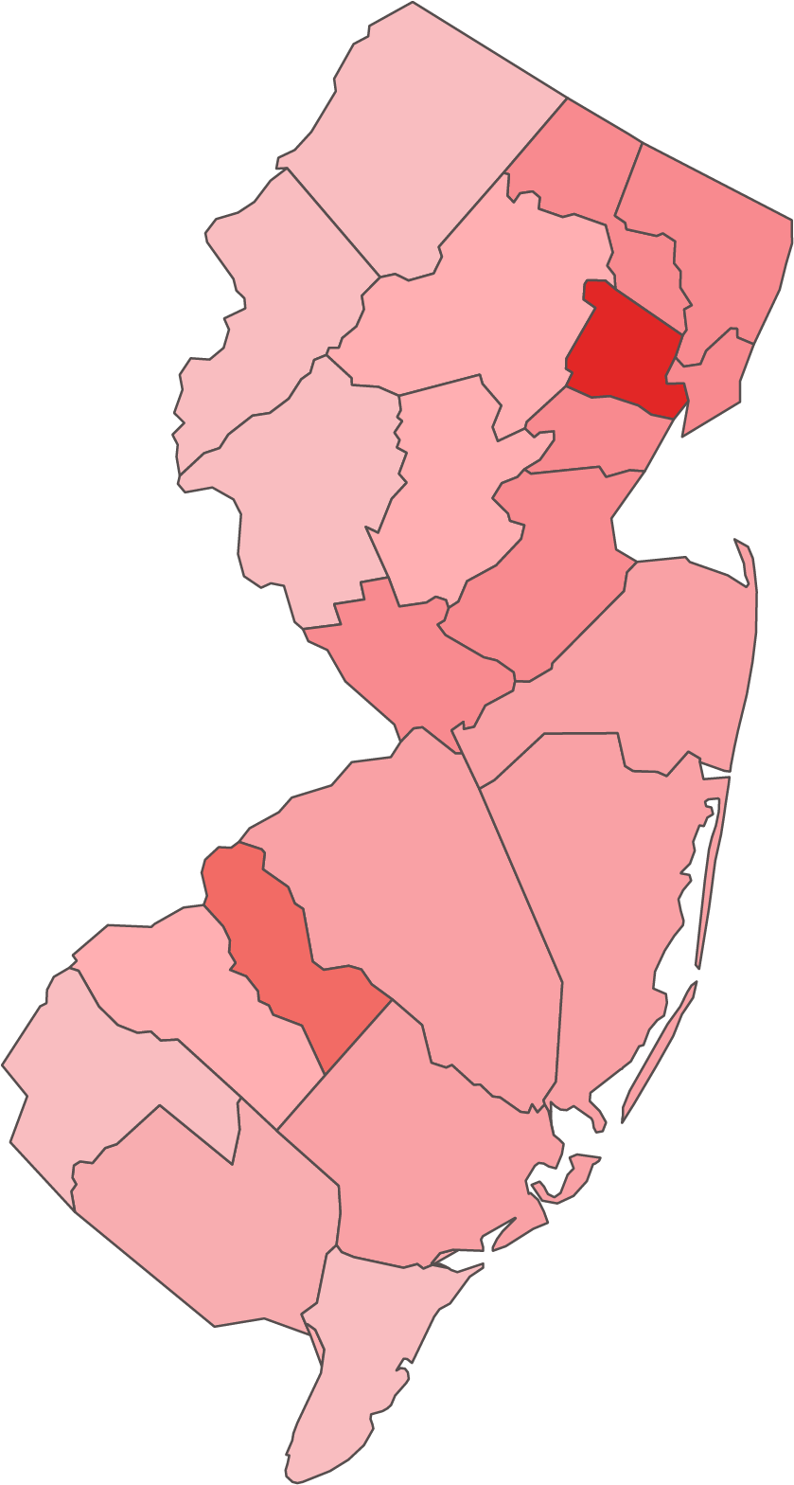
Expected No. of People Experiencing Homelessness in 2026 – 45+
Essex County
Camden County
Hudson County
Union County
Middlesex County
Mercer County
Bergen County
Passaic County
Atlantic County
Burlington County
Monmoth County
Ocean County
Gloucester County
Morris County
Cumberland County
Somerset County
Warren County
Salem County
1,035
408
337
319
307
273
268
268
229
221
200
183
120
110
109
92
55
54
0.4%
Compounded Annual Growth Rate
2026-2027
4,700
Source: Statista/AARP analysis of data available by United States Census Bureau (USCB)

Slide 10
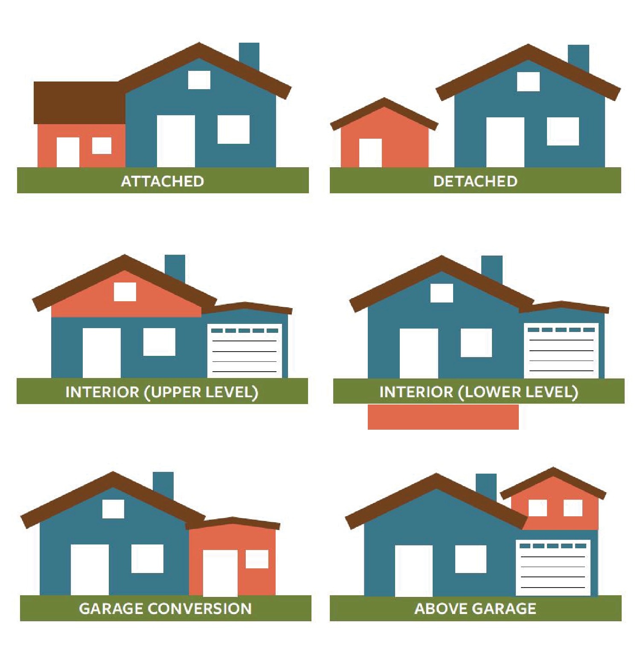
Accessory Dwelling Units
Accessory dwelling units (ADUs) are independent housing units, typically (but not always) created on single-family lots through remodeling or expanding the existing home or constructed as a detached dwelling
Definition Source: ADU Model State Act and Local Ordinance, Image Source: The ABCs of ADUs

Slide 11

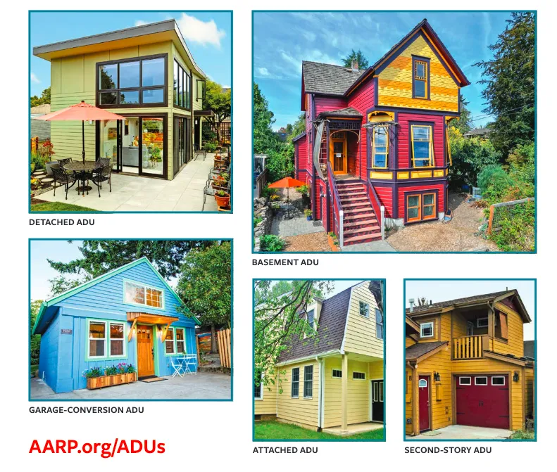
Visualizing ADUs
Source: https://www.aarp.org/livable-communities/housing/info-2019/accessory-dwelling-units-adus/

Slide 12
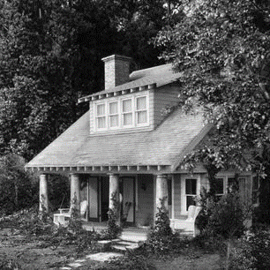

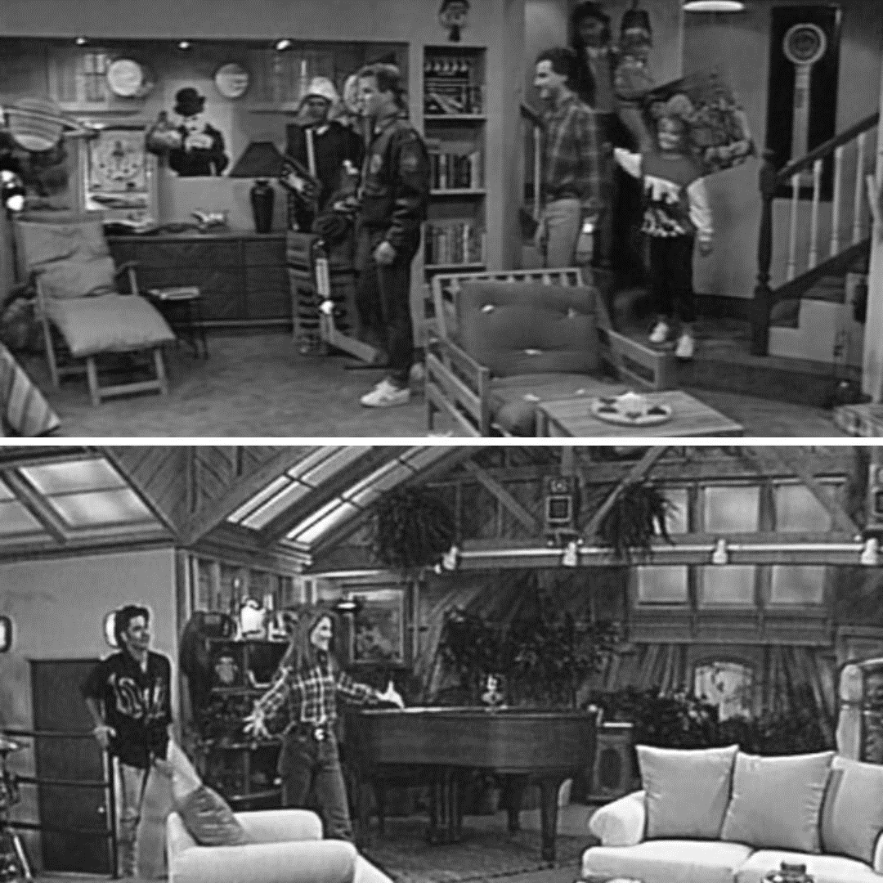
Famous ADUs in Movie and TV History
The Great Gatsby
(1925 novel by F. Scott Fitzgerald
and 2013 movie by Baz Luhrmann):
Nick's Delightful Rental Home
Happy Days (1974):
Fonzie's Garage Apartment
Full House (1987):
A Basement Bedroom and an Attic ADU

Slide 13






Older Adults & ADUs
Independent living space
Care of loved ones
Downsize
Extra Source of Income
Increasing Affordable Housing Options
Intergenerational Housing
Source: 2021 AARP Home and Community Preferences Survey: A National Survey of Adults Age 18+

Slide 14
ADU Legislative Landscape [Statewide]
Notes:
State | Year(s) | By-Right Permitting Required? | Ban on Owner Occupancy Requirements? | Limits on Parking Requirements?
Laws passed earlier in California, Washington, and Vermont had required that localities allow for ADUs but did not require by-right approvals.
 | Hawaii | 1981/2024 (5) | No | No | No
 | California (1) | 2016 | Yes | Yes | Yes
 |  | 2019
 | Washington (1) | 2023 | Yes | Yes | Yes
 | Oregon | 2017 | Yes | Yes | Yes
 |  | 2019
 | Utah | 2021 | No | No | No
 | Vermont (1) | 2020 | Yes | No | No
 | New Hampshire | 2016/2025 | No | No | No
 | Connecticut | 2021 | Mixed (2) | No | Yes
 | Maine | 2022 | No | No | No
 | Rhode Island | 2022/2024 | Yes (3) | Partial (3) | Yes
 | Colorado | 2024 | Yes | Partial (4) | Yes
 | Arizona | 2024 | Yes | No | No
 | Massachusetts | 2024 | Yes | Yes | Yes (6)
 | Iowa | 2025 | Yes (7) | Yes | Yes (7)
 | Maryland | 2025 | Yes | Yes | No (8)
 | Arkansas | 2025 | Yes | Yes | Yes
 | Montana (9) | 2023/2025 | Yes | Yes | --
 | Nevada (10) | 2025 | Yes | Yes | Yes
 | West Virginia | 2026 | Yes | Yes | Yes
 | Idaho | 2026 | Yes | Yes | Yes (11)
 | Virginia (12) | 2026 | No | Yes | No
 | North Carolina (13) | 2026 | Yes | Yes | Yes
01
Connecticut’s law requires by-right approvals. However, it also allows localities to opt out of this provision with a two-thirds vote of both their planning board and legislative body.
02
Rhode Island requires by right on owner occupied lots for family members,
on large lots, for internal ADUs, or for an ADU within an existing accessory structure. Owner occupancy required if applying “by right”.
03
04
Colorado requires owners to live in the primary unit while the ADU is being constructed.
05
Hawaii recently updated their ADU laws in May 2024
06
Massachusetts prohibits parking mandates within ½ mile of transit.
Iowa provides for no discretionary review or hearing and consistent with the time frame assigned to the approval of a single-family residence. Parking requirements cannot be more cumbersome than requirements for a single-family residence.
07
08
Requiring parking will include study of the cost and topography of property.
Montana’s 2025 SB 532 mandates counties to allow ADUs, prohibits them
from imposing certain restrictions and requires them to adopt specific regulations for these units.
09
10
It applies only to counties with a population of 100,000 or more or cities with the population of 60,000 or more.
Prohibit requiring any off-street parking or guest parking for any ADU unless the principal dwelling unit does not have off-street parking or the street is not paved and designed or constructed for on-street parking or unless the principal dwelling unit is within 1/4th mile of transit, an employment area, or commercial services.
11
The bill requires a permit to be obtained to build an ADU. Owner occupancy requirements are limited to only one unit, primary or the ADU. The bill allows for municipalities to mandate parking.
12
13
Applies only to cities with a population of 50,000 or greater.
Source: A Taxonomy of State Accessory Dwelling Unit Laws 2025
Notes:
SJ to present

Slide 15
States That Have Passed ADU Legislation
No legislation
Statewide ADU legislation
WA
ME
MT
ND
OR
MN
VT
ID
SD
WI
NY
NH
MA
WY
MI
RI
IA
PA
CT
NV
NE
OH
UT
IL
IN
NJ
CA
CO
WV
DE
KS
MO
VA
MD
KY
DC
TN
NC
AZ
NM
OK
AR
SC
MS
AL
GA
AK
TX
LA
FL
HI
U.S. Virgin Islands
Puerto Rico

Slide 16
ADU Legislative Landscape [Local] [Not Exhaustive]
Washington
Seattle
Oregon
Portland
New Hampshire
Concord, Nashua
Massachusetts
Boston, Salem
Rhode Island
Statewide
South Carolina
Charleston
1
11
44
45
24
34
Wyoming
Cody
Nevada
Sparks, Reno
Maine
Kentucky
Louisville
2
12
25
35
South Dakota
Meade County
Oklahoma
Blair, Oklahoma City, Tulsa
1
New York State
New York, West Chester, Rochester, Albany
Virginia
Alexandria, Arlington, Fairfax
3
13
8
25
26
36
11
10
17
21
23
Utah
Salt Lake City
Kansas
Wichita
9
26
44
Pennsylvania
Philadelphia, Manheim, Pittsburgh
Florida
St. Petersburg
4
14
3
18
45
27
37
2
24
New Mexico
Albuquerque, Sante Fe
Nebraska
Lincoln, Omaha, Blair City
12
15
16
22
27
28
New Jersey
Montclair, Princeton
Tennessee
Knoxville
5
15
4
19
20
32
30
28
38
14
42
31
36
29
Hawaii
Honolulu
Iowa
Cedar Rapids, Des Moines
35
Maryland
Annapolis, Anne Arundel, Frederick, Montgomery
Georgia
Atlanta, Decatur
6
16
38
33
29
39
5
13
34
Texas
Austin
Minnesota
St. Paul
40
39
Delaware
New Castle County, Kent County, Sussex County, Newark
Mississippi
Ocean Springs
7
17
7
41
30
40
Montana
Missoula
Wisconsin
Milwaukee, Madison, La Crosse
43
37
West Virginia
Jefferson County
Louisiana
New Orleans
8
18
6
31
41
Idaho
Boise
Illinois
Oak forest, Chicago
Washington, D.C.
Missouri
Colombia, St. Louis, Kansas City
9
19
32
42
North Dakota
Devils Lake, Bismarck
Indiana
Indianapolis, Fort Wayne,
Michigan
Ann Arbor, Lansing
Ohio
Cincinnati, Columbus, City of Bexley
Vermont
Burlington
North Carolina
Asheville, Raleigh, Wake County,
Town of Cary
Alaska
Anchorage
10
20
21
22
23
33
43
Notes:
SJ to present

Slide 17

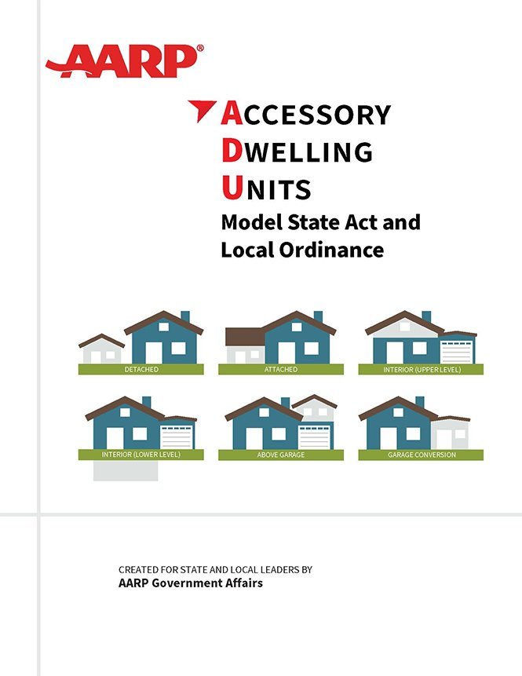
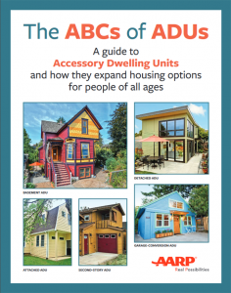

AARP’s ADU Publications
To learn more, visit
https://www.aarp.org/livable-communities/housing/info-2019/accessory-dwelling-units-adus.html
or scan the QR code
Source: AARP’s Model State Act and Local Ordinance,
Cover Art by Jennifer Goodman
Source: ABCs of ADUs, AARP Livable Communities

Slide 18
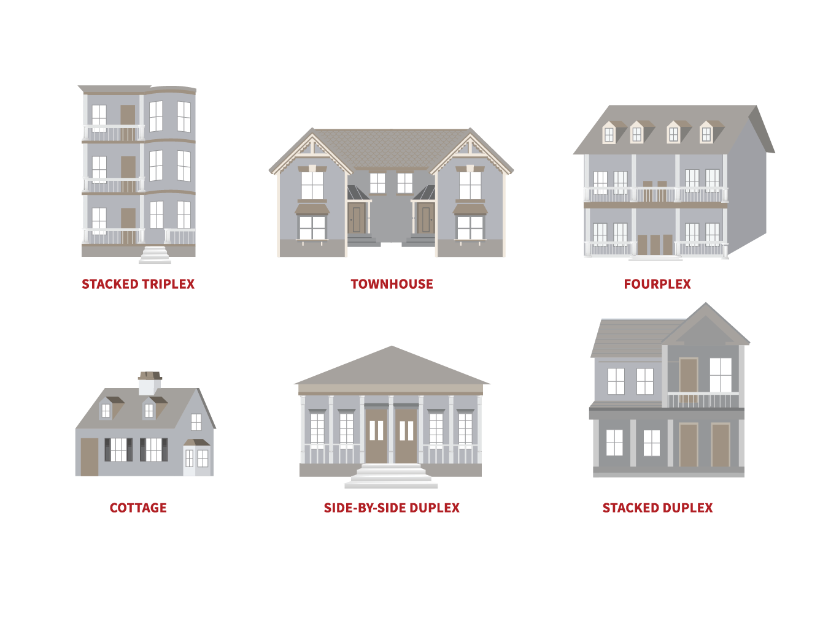
Middle Housing?
A group of different housing types that:
Have multiple housing units
Are more similar in scale to single-detached
homes than to apartment buildings

Slide 19
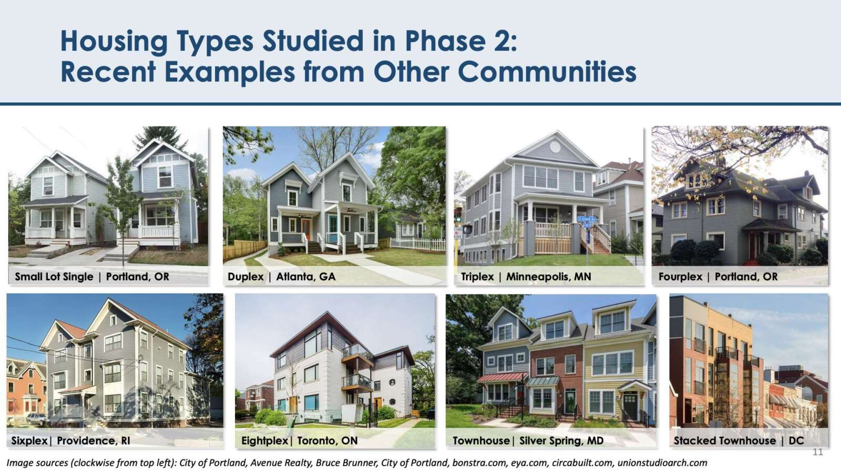
Visualizing Middle Housing
Source: https://www.arlnow.com/2022/05/02/new-missing-middle-draft-calls-for-legalizing-multifamily-housing-countywide/

Slide 20
Middle Housing Legislative Landscape (Statewide)
Middle Housing Legislative Landscape (Statewide)
(2025)
(2025)
(2025)
(2026)
California
California
Florida
Kansas
AB 130
SB 607
SB 1730
SB 418
Streamlined the development
of multi-family housing units
in already-developed urban
infill areas.
Streamlined infill development projects for housing, broadband, parks, and wildfire mitigation.
Allowed localities to approve multifamily or mixed-use affordable housing developments on parcels owned by religious institutions, regardless of existing zoning, provided that at least 10% of the units are affordable.
By-Right Housing Development Act, aims to address housing shortages and promote affordability in Kansas by streamlining the approval process for certain residential developments.
The bill reforms an outdated portion of the California Environmental Quality Act that had been abused in the housing approval process.
The bill reforms an outdated portion of the California Environmental Quality Act that had been abused in the housing approval process.
The bill will promote the development of housing by streamlining the approval process for by-right housing development, including single-family homes, townhouses and accessory dwelling units (ADUs).
Allowed affordable housing projects to be built taller and more densely, even in restrictive areas. The bill also encourages residential development near services and amenities to support aging in place.
The bill also increases accountability measures to ensure localities meet their housing targets.

Slide 21
Middle Housing Legislative Landscape (Local)
1
Seattle, WA: Adopted
(2018, and expanded in 2023)
6
Austin, TX: Adopted (2023)
1
13
Houston, TX: Adopted (2023)
16
Spokane, WA: Adopted
(2018, and expanded in 2023)
Dallas, TX: Adopted (2025)
2
20
14
15
12
16
St. Paul, MN: Adopted (2023)
Walla Walla, WA: Adopted (2018)
7
Fayetteville, AR: Adopted (2016)
17
Minneapolis, MN: Adopted
(2019, halted due to an
ongoing lawsuit)
Other midsize and larger cities in WA state: In progress
3
4
18
11
8
Decatur, GA: -
19
10
9
2
All midsize and larger cities
in OR: Adopted (2022)
9
7
17
Omaha, NE: In progress
Raleigh, NC: Adopted (2021)
Charlotte, NC: Adopted (2023)
8
3
San Francisco: Adopted (2022)
Ashville, NC: In progress
6
18
South Bend, IN: In progress
5
Sacramento, CA: In progress
Gary, IN: Adopted (2025)
Santa Rosa, CA: In progress
10
Arlington, VA: Adopted (2023)
San Diego, CA: In progress
19
Louisville, KY: In progress
11
Anne Arundel County, MD: Adopted (2026)
4
Salt Lake City, UT: In progress
12
Providence, RI: In progress
14
Buffalo, NY: Adopted (2017)
Montgomery County, MD:
In progress
20
Madison. WI: Adopted (2025)
5
Anchorage, AK: Adopted (2023)
Baltimore, MD: In progress
13
Portland, ME: In progress
15
Grand Rapids, MI: Adopted (2018)
Milwaukee, WI: Adopted (2025)
Source: Expanding Middle Housing Options: A Guide to Local Middle Housing Regulations, AARP Livable Communities, April, 2024

Slide 22

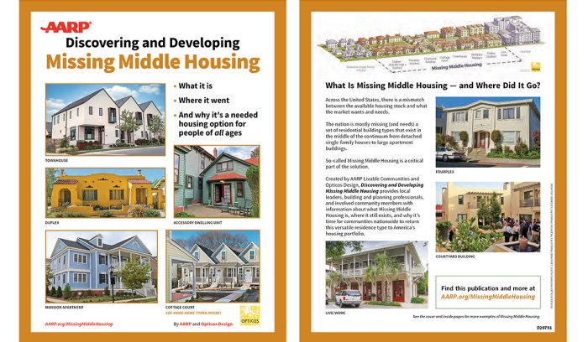
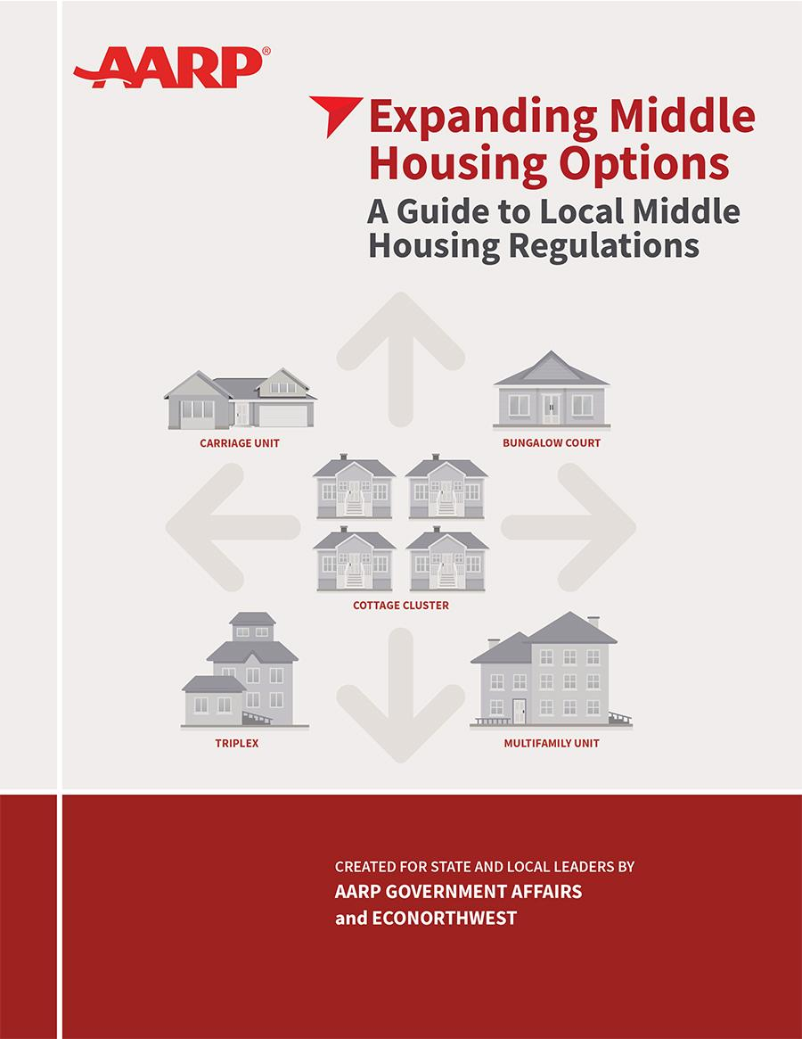
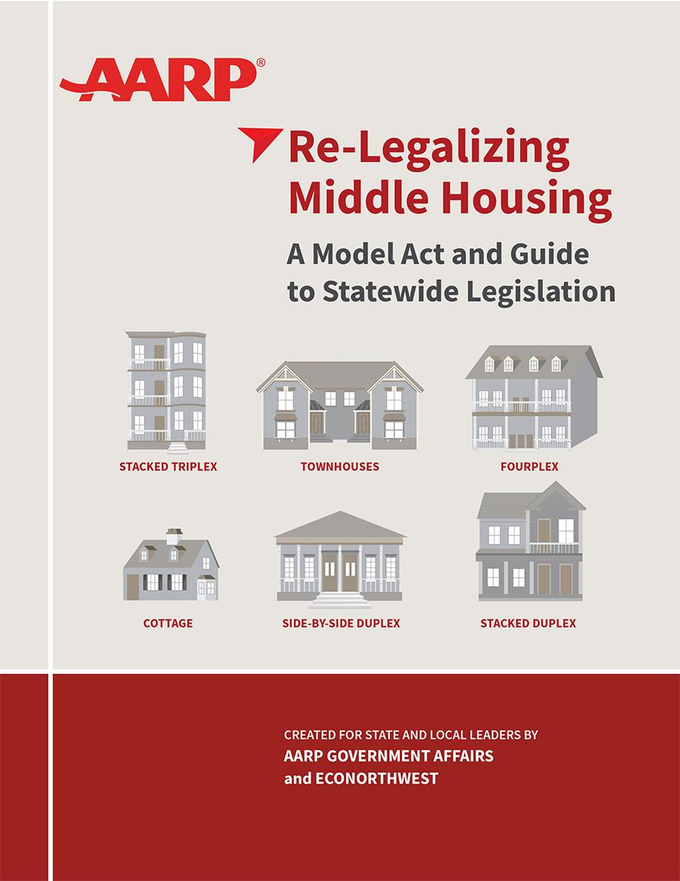


AARP’s Middle Housing Publications
To learn more, visit:
https://www.aarp.org/livable-communities/
Source: AARP’s Middle Housing Publication, AARP Livable Communities
Source: AARP’s Local Middle Housing Guide, Cover Art by Jennifer Goodman
Source: AARP’s State Middle Housing Model Act and Guide, Cover Art by Jennifer Goodman

Slide 23
What is Transit Oriented Development (TOD)?
Transit-oriented development is a development practice that includes a mixture of housing, office, retail and/or other commercial development and amenities integrated into a walkable neighborhood located within a half-mile of quality public transportation.
TOD attracts people and adds vibrancy and connectivity to the broader networks of communities.
TOD has been shown to provide a wide range of benefits to residents, local economies, and local and state authorities, such as municipal governments or transit agencies.

Slide 24
What People 50+ Think About TODs
At least
66%
75%
6 in 10
say it is important to them to have a variety of transportation options available in their community, such as buses, subways, and cabs.
39% say it’s extremely/very important to them.
of U.S. adults age 50+ would support legislation promoting transit-oriented development in their community.
36% would strongly support them.
adults across political parties say they would support transit-oriented development legislation.
> Democrat 88%
> Republican 62%
> Independent 75%
Source: AARP and NORC at the University of Chicago Foresight 50+ Omnibus, March 2026

Slide 25
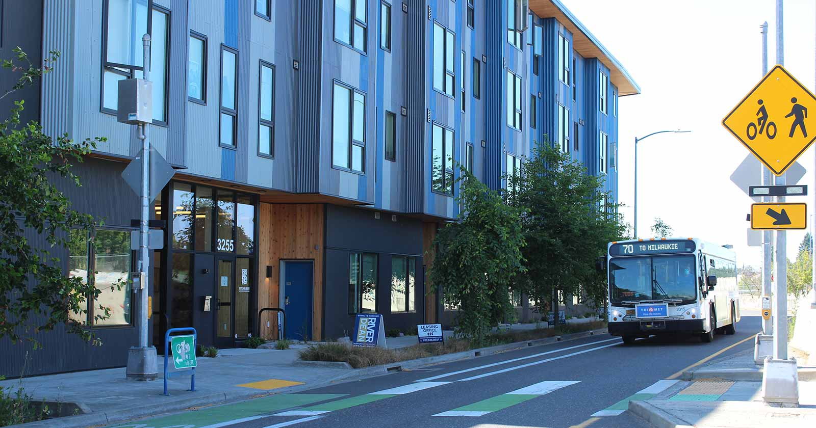
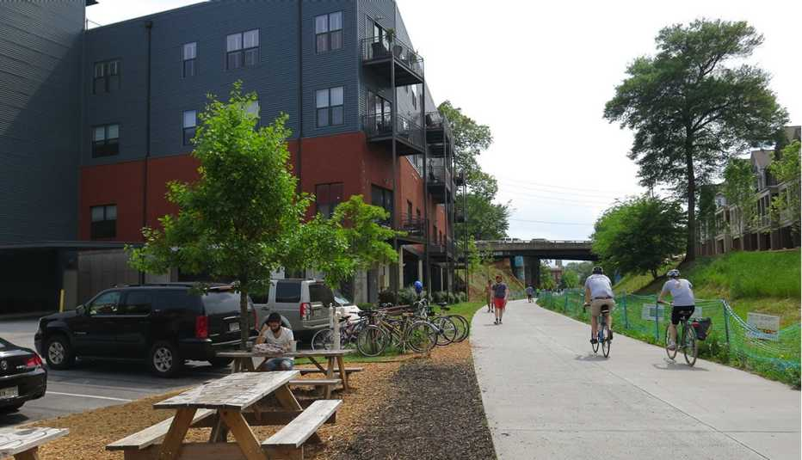
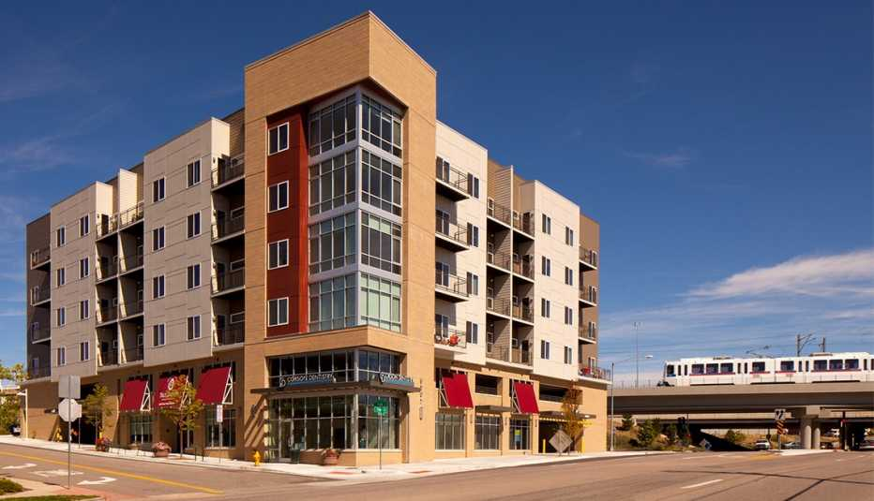
Visualizing TODs
Source: The Atlanta BeltLine, a 22-mile walk-bike path circling the city's downtown, has spurred the construction of all sorts of housing, offices, shops and more. https://www.aarp.org/livable-communities/getting-around/info-2017/transit-oriented-development-senior-housing-denver.html
Source: Yale Station Apartments is located adjacent to the Yale Station stop on the RTD light-rail. Denver Colorado. https://www.aarp.org/livable-communities/getting-around/info-2017/transit-oriented-development-senior-housing-denver.html
Source: TriMet MAX Orange Line around Dean River Apartments, Portand, Oregon, https://trimet.org/tod/

Slide 26
What is Universal Design in Housing?
Universal design is a design technique which creates public and private spaces for equal access by individuals of all ages and abilities.
Such features can be incorporated into private homes and residential facilities to facilitate aging in place and those with disabilities and mobility issues.
AARP released the HomeFit® Model Ordinance in July 2025.

Slide 27
What People 50+ Think About Accessibility in Homes
68%
59%
56%
67%
Believe it is important to design homes that accommodate people of all ages and abilities
Agree that universal design features should
be standard in all newly built homes
Want step-free entry ways included in all newly built homes
Want wide doorways
and hallways to accommodate
mobility devices
Source: AARP and NORC at the University of Chicago Foresight 50+ Omnibus, August 2025
Notes:
Tim Murphy

Slide 28

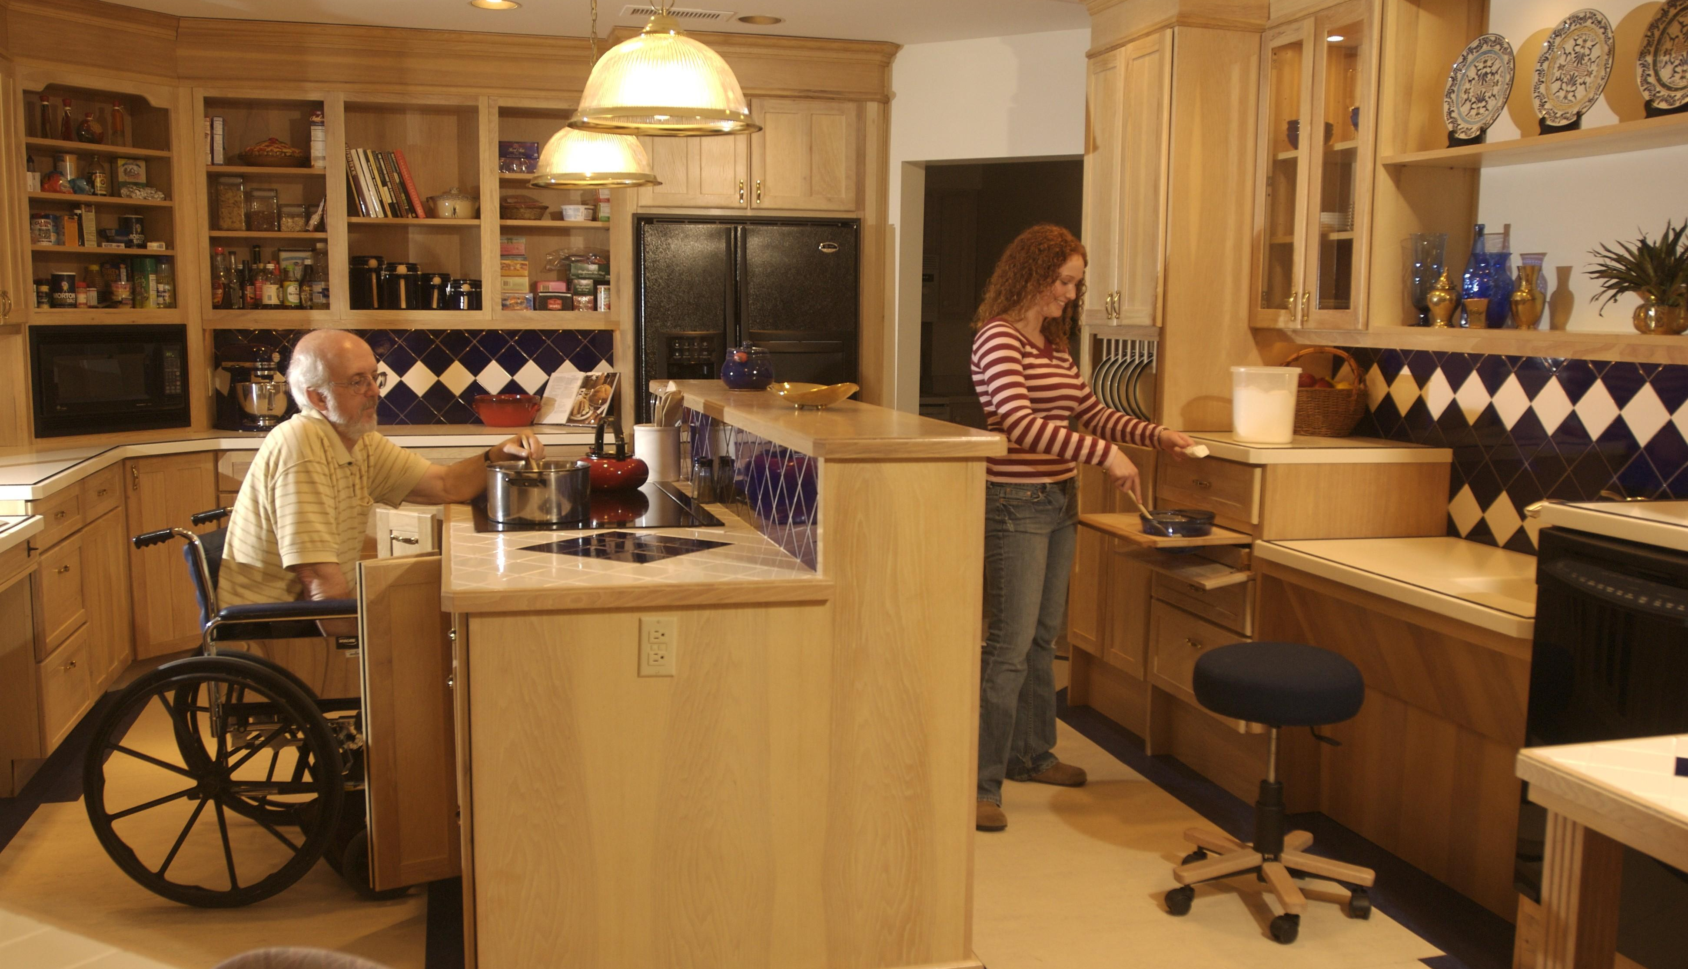
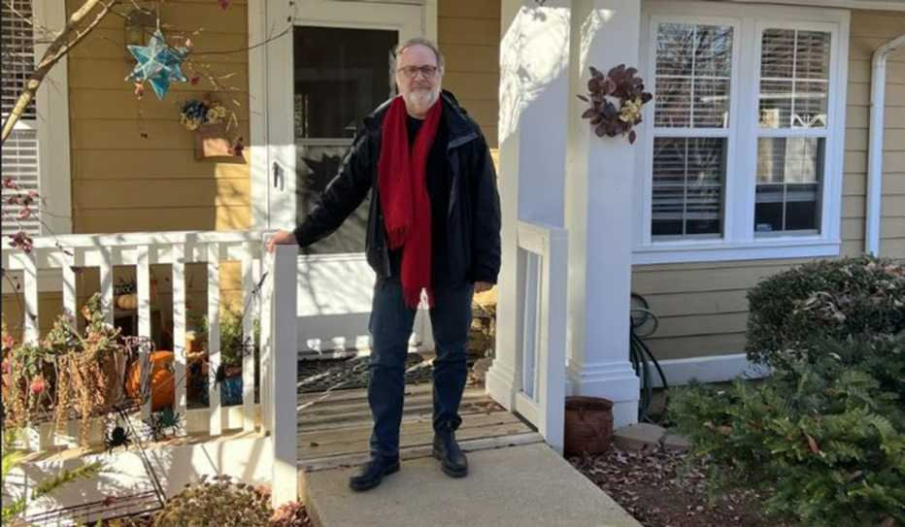
Visualizing Universal Design Features
Source: https://www.aarp.org/pri/topics/livable-communities/housing/universal-design/
Source: https://hcldr.wordpress.com/2014/05/16/home-care/
Source: https://www.aarp.org/livable-communities/housing/info-2023/video-universal-design.html

Slide 29
Universal Design in Housing – Legislative Examples
(2023)
(2023)
(2025)
(2025)
New York City,
New York
Prince George’s
County, Maryland
Sacramento,
California
Phoenix,
Arizona
Local Law 30 of 2023
Council Bill-065-2023
Universal Design (Accessibility Standards) for Residential Dwellings:
Adoption of Building Code Amendment
Main Lead:
Councilmember Crystal Hudson
Main Lead: Councilmember Jolene Ivey
This ordinance requires single family home builders to provide universal design features as an option available to buyers.
The City of Phoenix updated its building code to include new inclusive home design standards intended to increase accessibility for people with disabilities and support aging in place.
Elements of universal design will now be required for at least half of new single-family attached, single-family detached, two-family, and multi-family residential dwelling units constructed in Prince George’s County after January 1, 2026
Amends the administrative code of the city of New York in relation to the accessibility of units in new construction buildings
Developments of 15 units or more are required to offer basic universal design features to make homes more accessible.
Enhanced requirements for entrances, hallways, and bathrooms
Updated standards for household fixtures such as hardware, light switches, and other elements supporting accessible operation
Any developer receiving city
financial assistance must incorporate the universal design features in all of the dwelling units offered for rent in newly constructed housing development projects with 41 or more units
Universal design requirements under CB-65-2023 will apply to exterior entrances, interior routes of travel, the placement of some controls, switches, electrical sockets, and plugs, and would require a bathroom and kitchen on the first level
Universal design features – such as grab bars, no step entries, and wider doorways – are required to be offered in at least one model in each development phase.
This change aligns the city with the 2024 International Code Council’s standards and will improve accessibility for those with mobility challenges

Slide 30
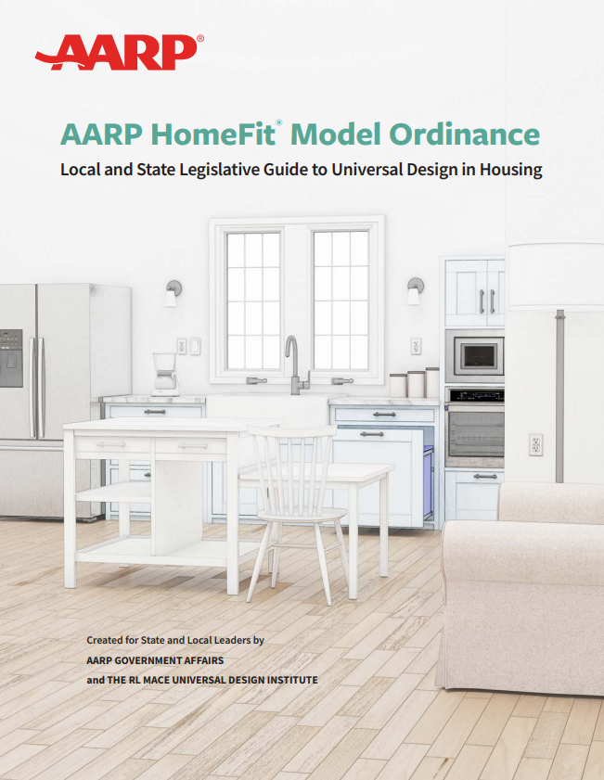



AARP HomeFit®
Publications
To learn more, visit:
AARP HomeFit®
Model Ordinance:
www.aarp.org/HomeFitModelOrdinance
AARP HomeFit® Guide:
www.aarp.org/HomeFit
Notes:
SJ

Slide 31

Funding Affordable Housing
North Dakota - Allocated $25M to the Housing Finance Agency’s Housing Incentive Fund. This fund helps communities across the state build more age-friendly, affordable housing.
Delaware - Allocated $4M to its Housing Development Fund to help build more affordable housing. This funding will help address Delaware’s shortage of affordable housing, which has driven up home prices, rent and homelessness rates.
Ohio - Allocated $47M per year to the Welcome Home Ohio program. That provides funds to local land banks for the development of affordable housing, rehabilitation and constructing residential homes.
Maine - Increased the maximum amount of its Historic Property Rehabilitation Tax Credit that can be claimed in the first two project years from $5M to $10M. These tax credits can be used to convert Maine’s historic structures such as mills, schools, churches and grange halls into housing that the state critically needs.
Big push for funding affordable housing by states
Arizona - Allocated $5M to its Area Agencies on Aging to provide housing assistance to low-income, aging individuals across the state.
Vermont - Allocated an additional $235K to expand the HomeShare Vermont program statewide. This extra funding will allow expansion to the most rural counties, providing additional housing resources for some of the state’s most vulnerable populations.
Hawaii - Established the Mixed-Income Subaccount within its Rental Housing Revolving Fund. The Subaccount will support the development of mixed-income housing in transit-oriented development areas.
Kentucky - Established the State Aid Funding for Emergencies fund, providing up to $100M in disaster relief funds to support housing development in counties most affected by flooding.
Oregon - Allocated an additional $11M to the Homeless Prevention Services Emergency Rent Assistance fund. The fund provides financial assistance and support services to households facing homelessness.
North Carolina - Created the Small Rental Rehabilitation Program that specifically targets owners of one to four rental units per property that were damaged by Hurricane Helene. Property owners must agree to provide affordable rent rates for a 10-year period following program construction to be considered for assistance.
Picture Source: https://www.shutterstock.com/image-photo/saving-money-home-loan-mortgage-property-1318396043

Slide 32

Funding Affordable Housing
Big push for funding affordable housing at the local level – 2024/25 Examples
Austin, Texas- Passed a resolution that improves access to capital by partnering with local financial institutions, establishes a taskforce aimed at reducing development costs and streamlining development, and expands education and outreach to empower homeowners with information about rights, protections, and programs.
New Orleans, Louisiana - Approved the creation of the Housing Trust Fund, which will dedicate 2% of the city’s surplus budget to affordable housing programs. These programs will benefit older adults on fixed incomes, low- to moderate-income families and individuals with disabilities.
Pittsburgh, Pennsylvania - Allocated $4M toward safe, digitally connected affordable housing options across the city through new development and redevelopment projects.
Miami-Dade County, Florida - Reinstated funding for the Miami-Dade Age-Friendly Initiative in its 2024-2025 budget. These funds will be used to implement the Miami-Dade Age-Friendly Action Plan in creating age-friendly affordable housing.
New York City, New York - Allocated $5B to create 80,000 additional housing units. The funding will be used for support infrastructure, including sewers, street maintenance, open spaces and additional staff at housing agencies.
Evansville, Indiana - Appropriated $1 million toward the city’s Affordable Housing Trust Fund. The Fund supports housing developers and residents in need of low-to-no interest loans for housing development, preservation/repairs and accessibility modifications.
Philadelphia, Pennsylvania - Allocated $22.5M to housing stability and the preservation of aging homes, $5M to expand rent subsidies, $12M to frontline housing counselors to prevent evictions, and $1M to support nonprofits that develop affordable housing. These funding decisions support affordable housing and housing stability across the city.
Dallas, Texas - Increased funding for affordable housing from $4.8 million to $24.5 million.
Picture Source: https://www.shutterstock.com/image-photo/saving-money-home-loan-mortgage-property-1318396043

Slide 33
Legislative Action: Unfair Service Agreement
WA
ME
MT
ND
2023
OR
MN
VT
16 Bills Passed
ID
SD
WI
NY
NH
WY
MI
NE
IA
PA
NV
UT
IL
OH
CO
IN
WV
CA
KS
MO
VA
KY
TN
NC
2024
14 Bills Passed
AZ
NM
OK
AR
SC
MS
AL
GA
AK
TX
LA
FL
HI
2025
3 Bills Passed
MA
RI
DE
MD
CT
NJ
DC

Slide 34


Legislative Guide to Residential Real Estate Wholesaling: Report and Model Act
Model Bill:
Research on Residential Wholesaling Practice
1
Regulatory Framework and Definitions​:
The Act defines key terms and provides a clear regulatory framework for residential wholesaling practices.​
2
Licensure and Valuation Requirements​:
Wholesalers must be licensed, insured, and provide independent property valuations funded by themselves.​
Review of the current legislative and regulatory framework
3
Disclosure and Consumer Rights​:
The Act mandates full disclosures to homeowners and grants an absolute right to cancel contracts before title transfer.​
Provides a Legislative Landscape- State and Local
View the Guide
Challenges & Recommendations
4
Enforcement and Protections​:
Penalties for violations and a public 'Do Not Solicit' list protect consumers from predatory practices.​

Slide 35


21st Century ROAD to Housing Act
The most significant federal housing law in a generation — a bipartisan win for the 50-plus facing rising costs, aging homes, and limited options to age in place.
4
87–8
AARP-endorsed bills
enacted in the package
Senate cloture vote —
overwhelming bipartisan support
396–13
75%
House vote on the amended package
of older adults want
to age in place
AARP Government Affairs | Livable Communities

Slide 36










P.L. 119-101
Key provisions for people 50+
Whole-Home Repairs
Aging in Place
Grants & forgivable loans to fix health hazards and make aging homes safer to live in.
More diverse options—duplexes, ADUs, smaller units—so owners can right-size and stay.
Rural Housing
GAO Section 202 Study
Preserves affordable housing for roughly 400,000 rural families and seniors.
Examines barriers to scaling affordable Supportive Housing for the Elderly.
Investor Limits
Small-Dollar Mortgages
Bans large institutional buyers of single-family homes; senior living communities exempt.
Pilot expands access to loans of $100,000 or less for lower-priced homes.
Home & Repair Financing
Disaster Recovery
New funding to convert vacant buildings, finance ADUs and manufactured homes.
Authorizes CDBG-DR to speed aid to disaster-hit communities where many seniors live.
Sources: AARP; U.S. House Financial Services Committee fact sheet; LeadingAge; Bipartisan Policy Center.

Slide 37



What It Means for Older Americans
Four AARP-endorsed bills tied directly to the priorities of older adults and their families
Reforming Disaster Recovery Act
Whole-Home Repairs Act
Rural Housing Service Reform Act
Housing Supply Frameworks Act
HUD grants for critical health, safety, and accessibility repairs — helping fixed-income homeowners age in place.
Faster, better-coordinated recovery to help older adults rebuild after disasters.
Preserves rent-assisted rural housing, protecting older renters from displacement.
Helps states cut red tape and expand supply — without overriding local zoning.
Overarching Goals
Next: A Rapid, Complex Implementation
Expand the housing supply amid a shortage of up to 5.5M units
Lower costs and improve affordability for those on fixed incomes
Help older adults age in place and stay in their communities
HUD, Treasury, VA, USDA, CFPB and banking regulators face dozens of deadlines — many due within 6–12 months. AARP will keep working with Congress and the Administration to implement the law effectively.
AARP Government Affairs | Livable Communities

Slide 38


Thank you!
AARP Livable Communities
AARP.org/Livable

